Slide 1

Data Analysis on Asian Dramas from 1986 to 2023 using Power BI
BY
KORADA VIJAYA ANJALI
ADITYA UNIVERSITY
21A91A6148

Slide 2

INDEX
INTRODUCTION
TECHNOLOGIES USED
WHY DATA ANALYSIS
DEVELOPMENT AND RESULTS
CONCLUSION

Slide 3

01. INTRODUCTION
Overview of the project: Analyzing Asian drama trends and ratings.
Importance: Helps understand the evolution and reception of Asian dramas over the years.
Timeline of the dataset : Data covers 1986 to 2023.
My project contains the charts of Asian dramas ratings on every year from 1986 to 2023 and its detailed information like language, number of episodes, name of the drama.

Slide 4
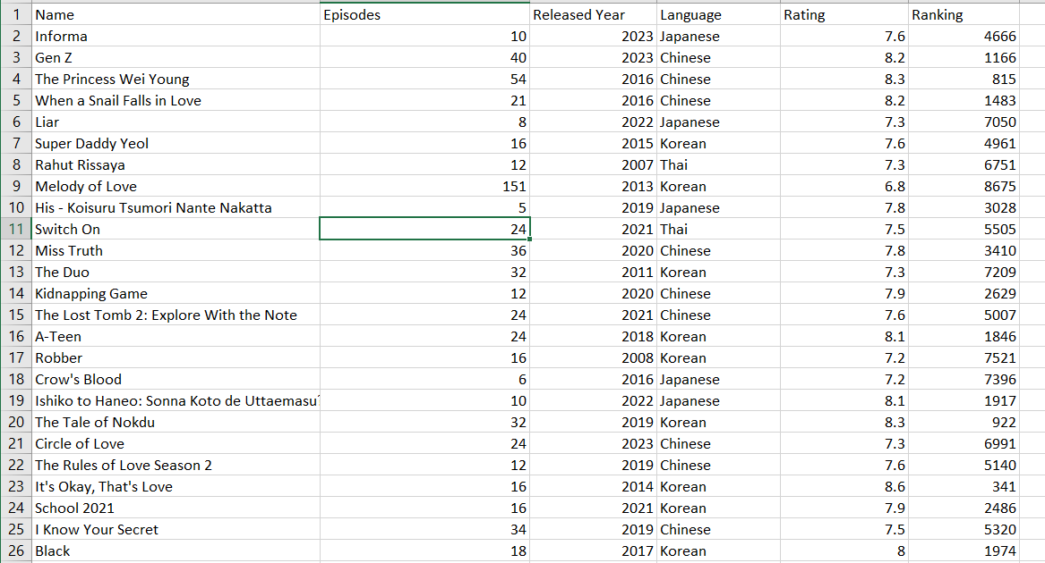
02.TECHNOLOGIES USED
KAGGLE
POWER BI
BAR PLOTS
PIE CHARTS

Slide 5

03. WHY DATA ANALYSIS
Understanding Trends
Gaining Insights
Improving Decision-Making
Identifying Opportunities and Risks
Enhancing Efficiency and Productivity
Supporting Innovation
Measuring Performance
Competitive Advantage

Slide 6
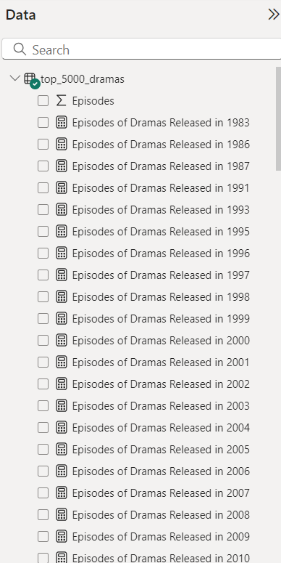
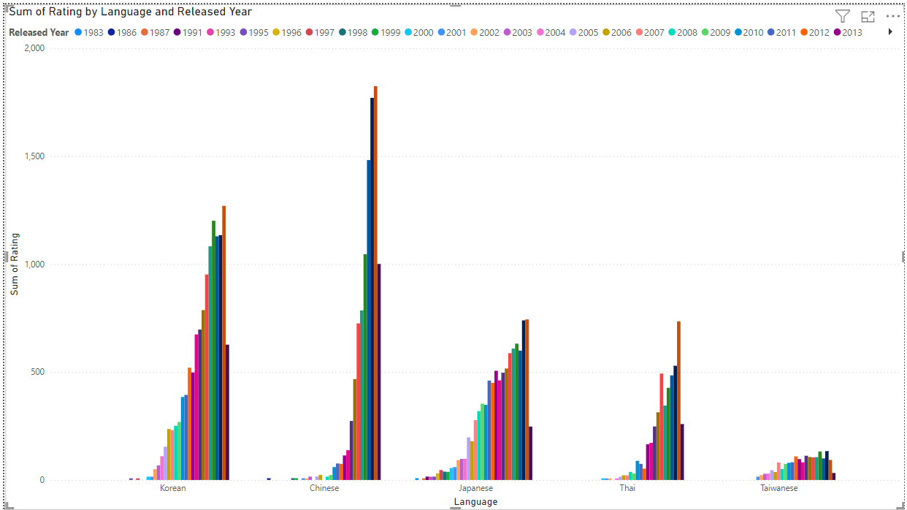
04. DEVELOPMENT AND RESULTS
Creating measure like:
Language of the drama released in year with rating
Name of the drama released in particular year
Number of episodes in that drama follows measure 2

Slide 7
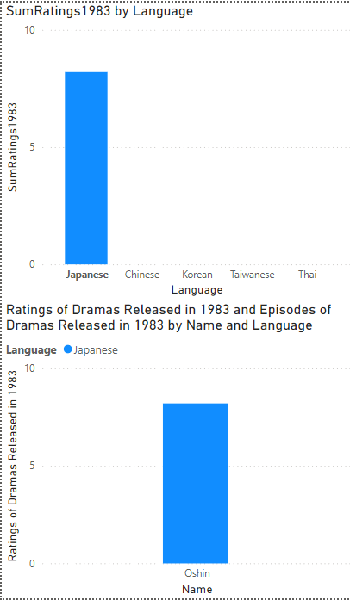
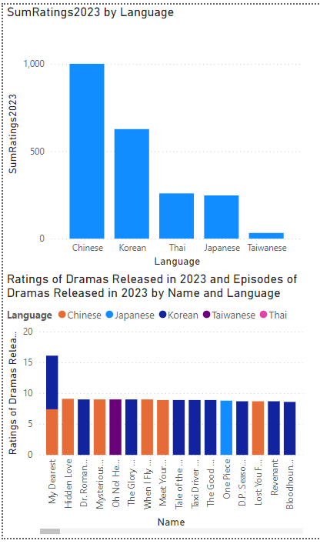
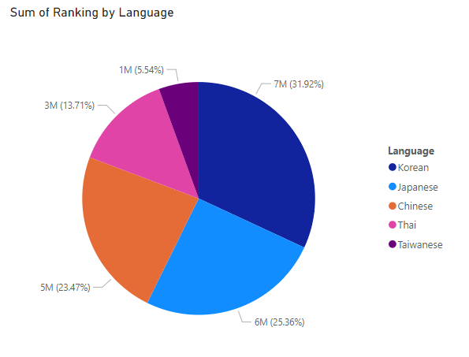

Slide 8
07. CONCLUSION
In this project, I successfully conducted a comprehensive data analysis on Asian dramas spanning from 1986 to 2023 using Power BI.
Key Achievements:
Implemented a detailed analysis to identify trends, top languages, and high-rated years.
Developed interactive visualizations to effectively showcase the insights.
Insights Gained:
Trend Analysis: Discovered significant trends in drama releases and ratings over the years.
Language Popularity: Identified which languages consistently received high ratings in specific years.
Yearly Highlights: Highlighted years with notable drama releases and exceptional ratings.

Slide 9


